Slide 1
Python based Shaderpipeline in VRED
Notes:
How to implement and use shader pipelines in VRED
Implement one simple material mapper, but also one that is a little more complex
Python scripting

Slide 2
Ideenkultivierung GmbH
3D-Design
Interactive Visualization
Software-Development
Trainings (e.g. CAD, VRED, Scripting)
Notes:
3D-Design
Interactive Visualization
Software-Development
Trainings (e.g. CAD, VRED, Scripting)

Slide 3
[VRED Shading Demo]
Notes:
Look at all materials in the imported file
Get the RGB values of the diffuse channel using the field access
Use lookup table to find a matching color
If there is a matching color -> replace material!

Slide 4
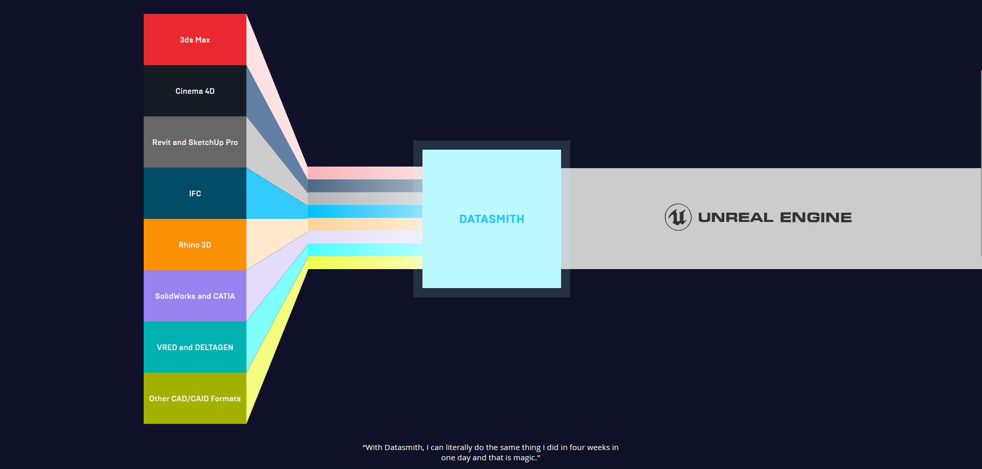
Examples in the wild

Slide 5
Implementing Shaderpipelines in VRED
Use an automated shaderpipeline in VRED to do the time consuming work
Automatically apply materials by using material libraries
Use color coded base-materials or material names to shade the model
Use fuzzy matching to shade even faster
Notes:
Use an automated shaderpipeline in VRED to do the time consuming work
Automatically apply materials by using material libraries
Use color coded base-materials or material names to shade the model
Use fuzzy matching to shade even faster

Slide 6
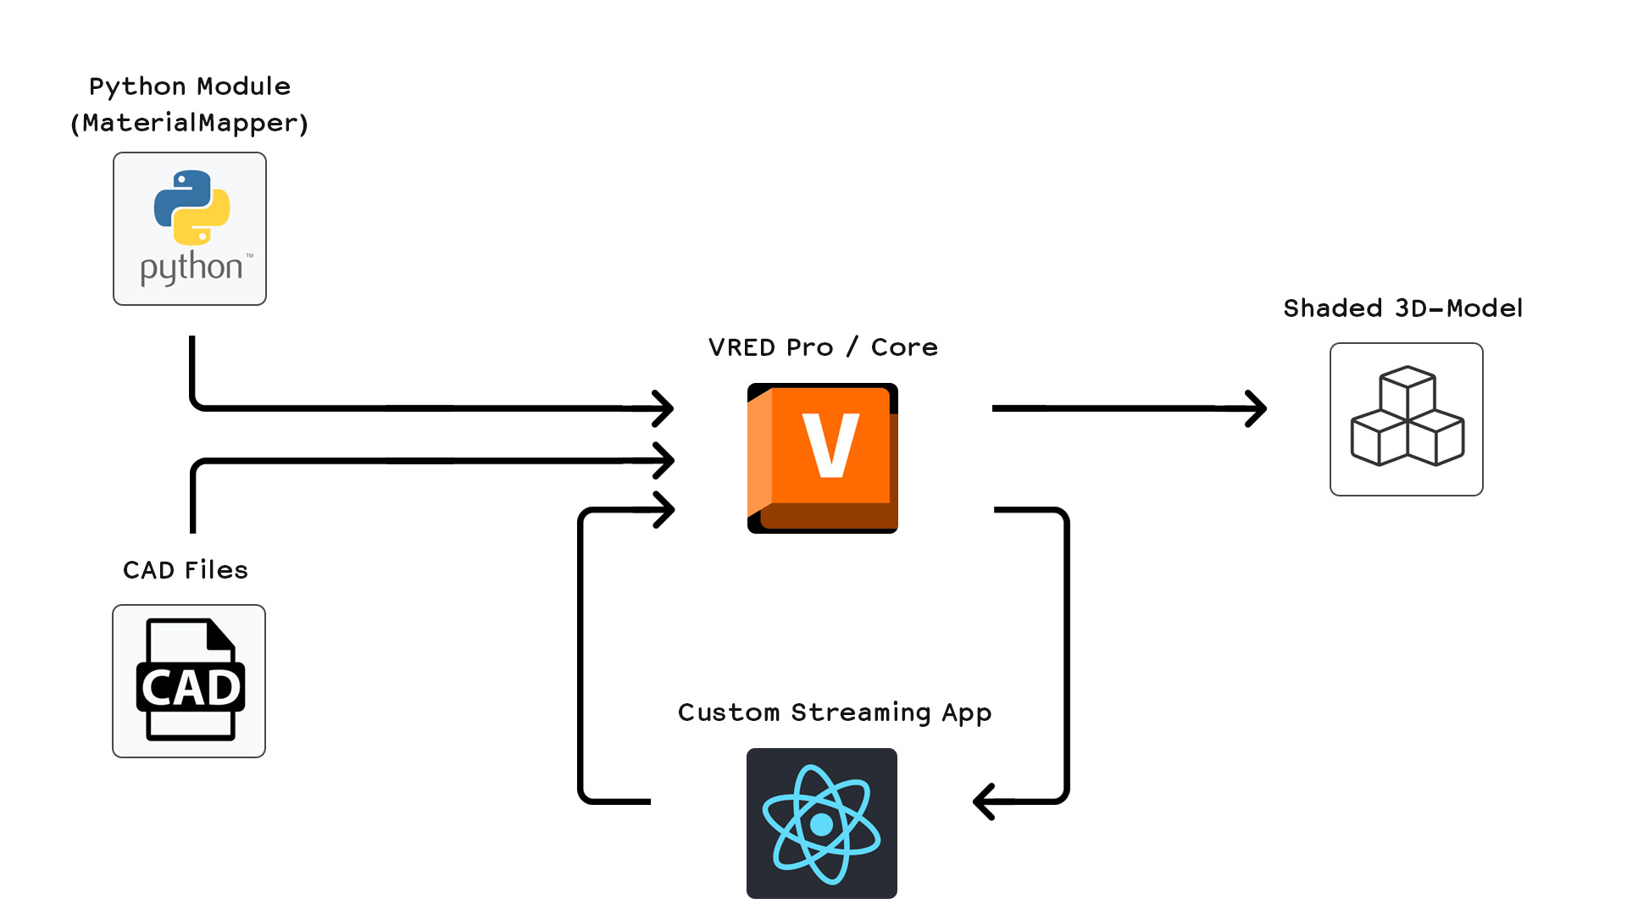
Project Overview
Notes:
VRED Streaming App to control pipeline
React Web App (Streaming App)
But: Could be just scripts, could be fully automated, could be a plugin in VRED, …
Python modules (MaterialMapper)
Mapping tables
Today: Only the material mapping part is discussed

Slide 7
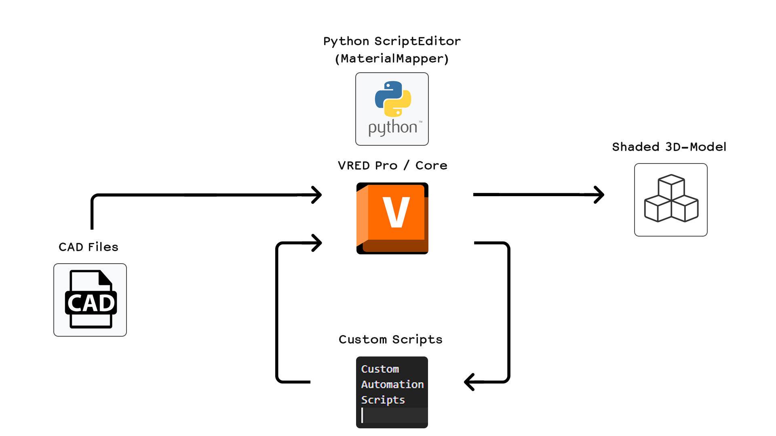
Project Overview
Notes:
VRED Streaming App to control pipeline
React Web App (Streaming App)
But: Could be just scripts, could be fully automated, could be a plugin in VRED, …
Python modules (MaterialMapper)
Mapping tables
Today: Only the material mapping part is discussed

Slide 8
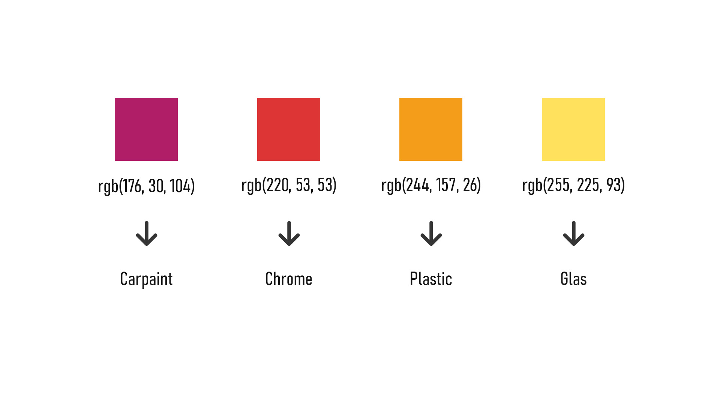
Prerequisits: Common Standards
Notes:
Agree on material naming conventions or RGB-color values (most-general case)

Slide 9
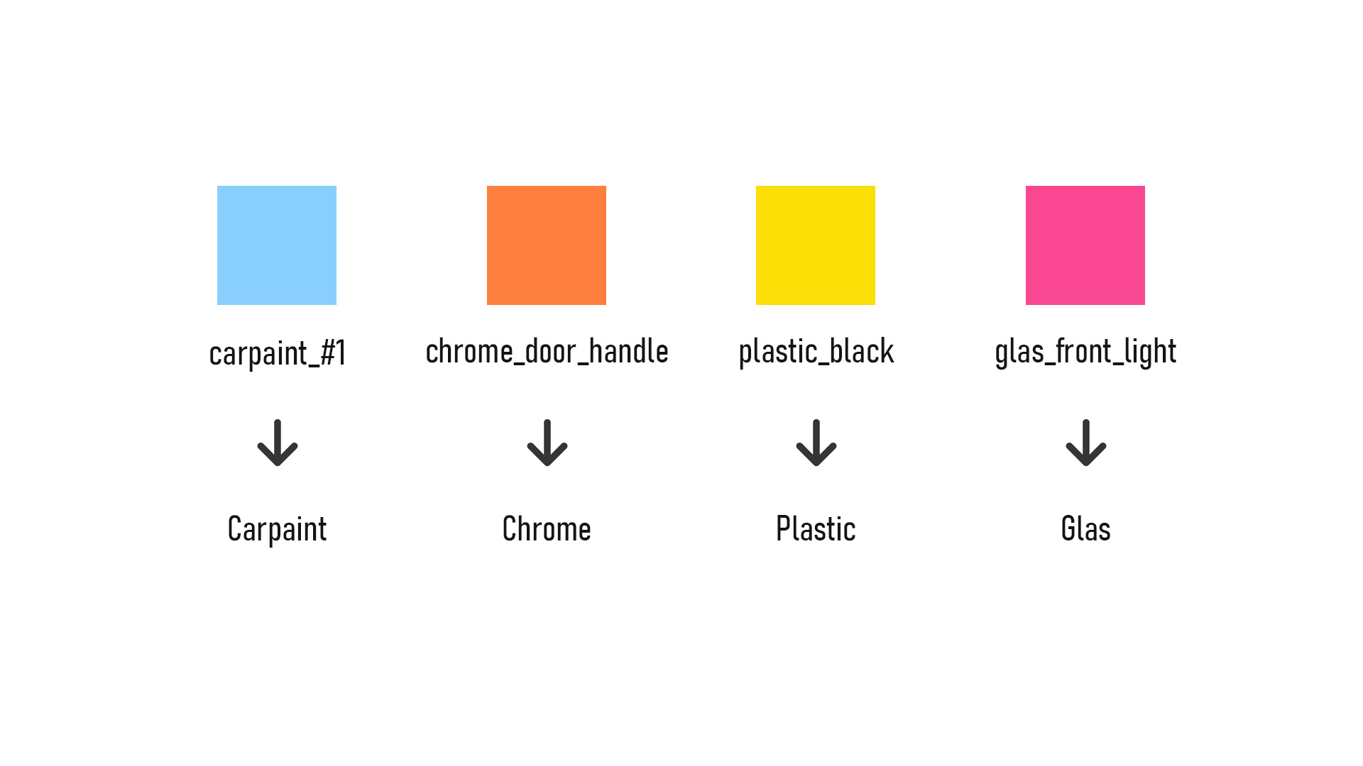
Prerequisits: Common Standards
Notes:
Agree on material naming conventions or RGB-color values (most-general case)

Slide 10
[VRED Shading Demo]
Notes:
Look at all materials in the imported file
Get the RGB values of the diffuse channel using the field access
Use lookup table to find a matching color
If there is a matching color -> replace material!

Slide 11
Matching Colors
Look at all materials in the imported file
Get the RGB values of the diffuse channel using the field access
Use lookup table to find a matching color
If there is a matching color -> replace material!
Notes:
Look at all materials in the imported file
Get the RGB values of the diffuse channel using the field access
Use lookup table to find a matching color
If there is a matching color -> replace material!

Slide 12
Matching Names
Look at all materials in the imported file
Get the name of the material
Use lookup table to find a matching name
If there is a matching name -> replace material!
Notes:
Look at all materials in the imported file
Get the name of the material
Use lookup table to find a matching name
If there is a matching name -> replace material!

Slide 13
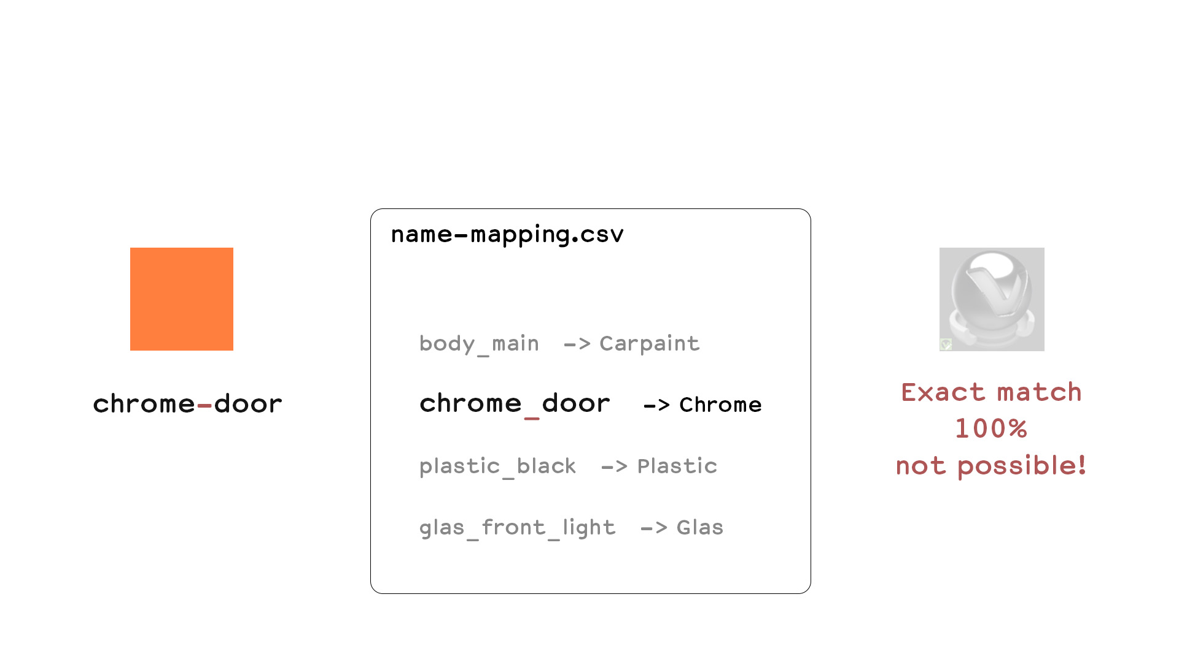
Fuzzy Matching
Notes:
Fuzzy Matching: Find also matches that are not 100% correct
Making errors is human
RGB values are off by a few percent
Material names have spelling errors
Fuzzy Matching calculates a ratio on how similar two things are
Helpful when doing fast iterations where not everything is correctly set up
Keep working while a colleague fixes materials at the source
Prevent manual fixing of shading problems

Slide 14
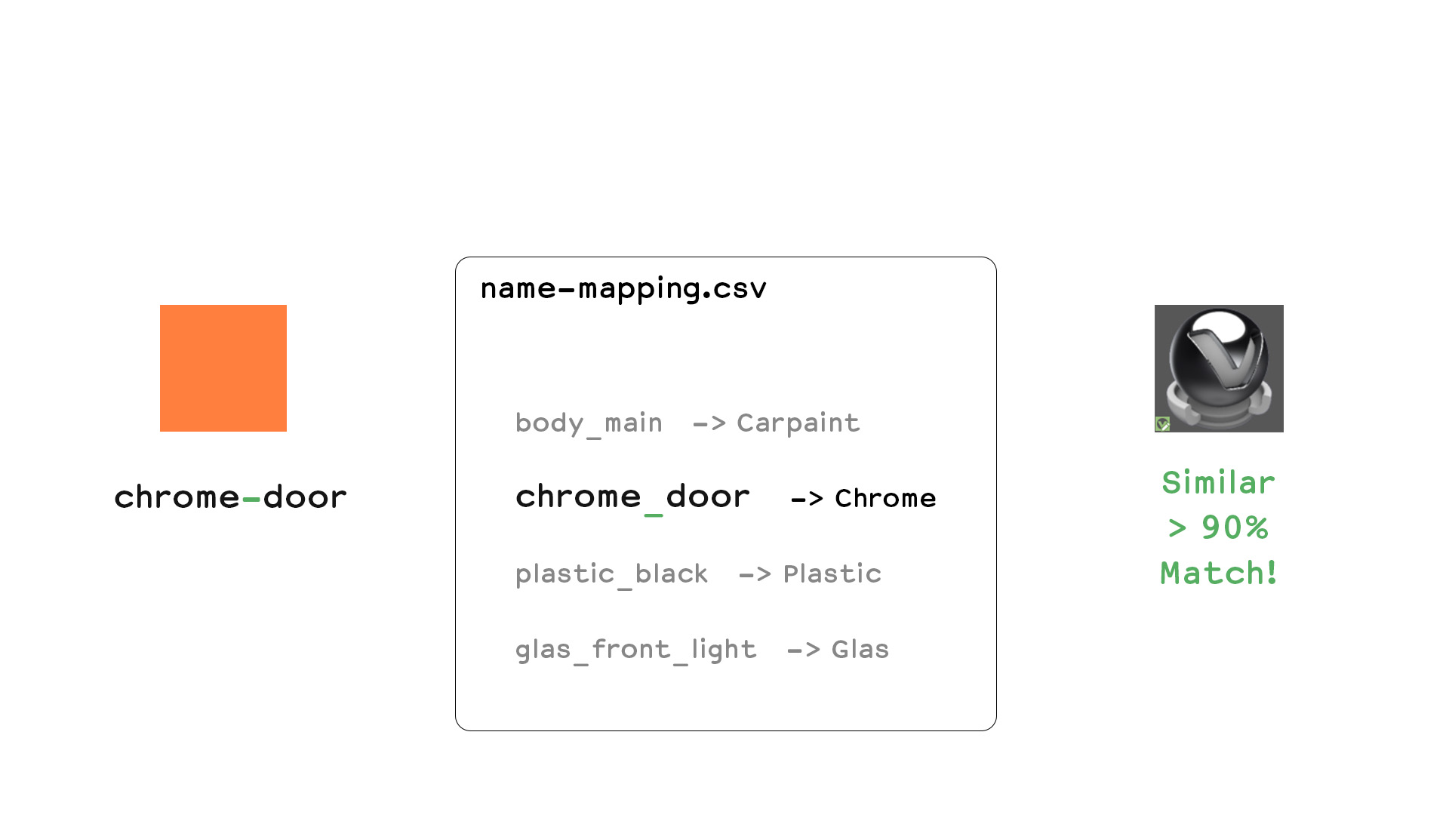
Fuzzy Matching
Notes:
Fuzzy Matching: Find also matches that are not 100% correct
Making errors is human
RGB values are off by a few percent
Material names have spelling errors
Fuzzy Matching calculates a ratio on how similar two things are
Helpful when doing fast iterations where not everything is correctly set up
Keep working while a colleague fixes materials at the source
Prevent manual fixing of shading problems

Slide 15
[VRED Shading Demo]
Notes:
Look at all materials in the imported file
Get the RGB values of the diffuse channel using the field access
Use lookup table to find a matching color
If there is a matching color -> replace material!

Slide 16
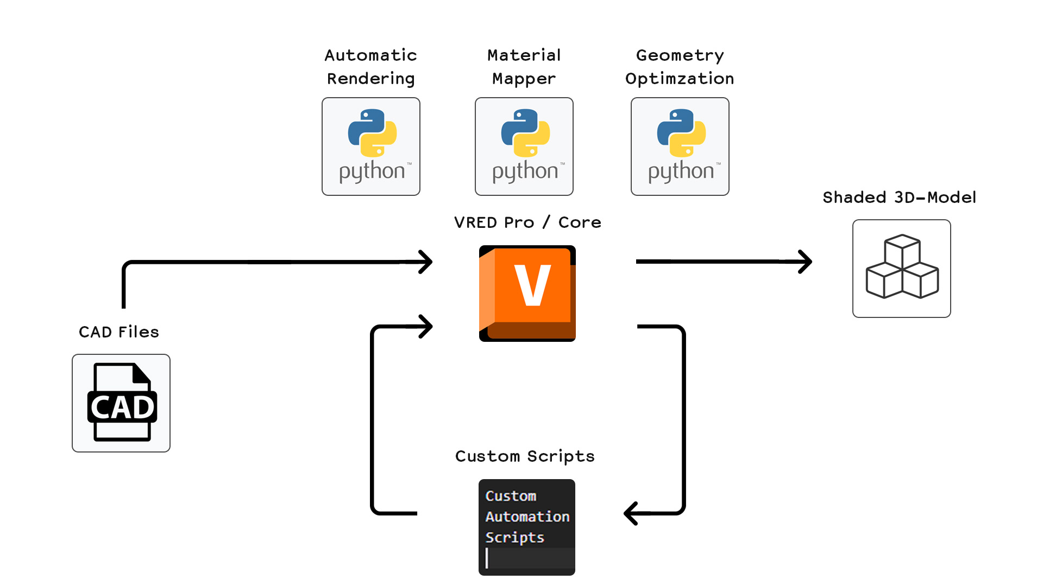
Automate Everything
Notes:
Automatically Optimize for VR
Merge geometries
Merge materials
Use special material libraries with VR-optimized materials
Reduce hierarchy depth
Automatically sort hierarchy based on materials

